Slide 1


MATH 242
Analytic Geometry and Calculus B
Section 12
Instructor: Jacob Wyngaard
Integration of Rational Functions and Partial Fractions

Slide 2
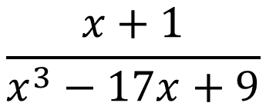
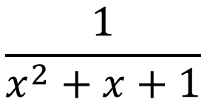
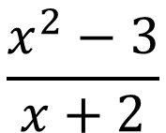
Background
  Rational functions are fractions involving two polynomials
$$\frac{x+1}{x^{3}−17x+9}$$
$$\frac{x^{2}−3}{x+2}$$
$$\frac{1}{x^{2}+x+1}$$
  Rational functions are called improper if the degree of the numerator polynomial is greater than the degree of the denominator polynomial
  Rational functions are called proper if the degree of the numerator polynomial is less than the degree of the denominator polynomial
  Today’s lecture covers integrating proper rational functions. If you want to integrate improper rational functions, you convert to proper by polynomial long division (not covered in MATH 242)

Slide 3
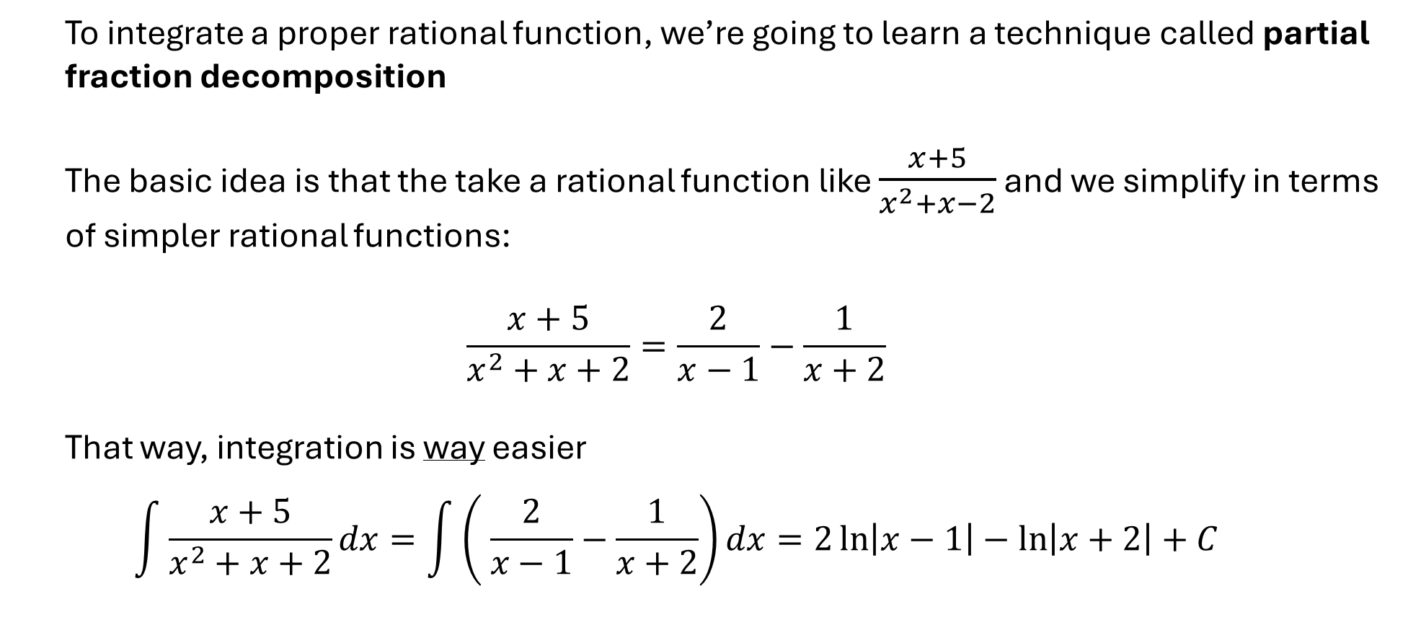
Partial Fraction Decomposition
  To integrate a proper rational function, we’re going to learn a technique called partial fraction decomposition
  The basic idea is that the take a rational function like $\frac{x+5}{x^{2}+x−2}$ and we simplify in terms of simpler rational functions:
  $$\frac{x+5}{x^{2}+x+2}=\frac{2}{x−1}−\frac{1}{x+2}$$
  That way, integration is way easier
  $$\int{\frac{x+5}{x^{2}+x+2}dx}=\int{\left( \frac{2}{x−1}−\frac{1}{x+2}\right)dx}=2\ln\left|x−1\right|−\ln\left|x+2\right|+C$$

Slide 4
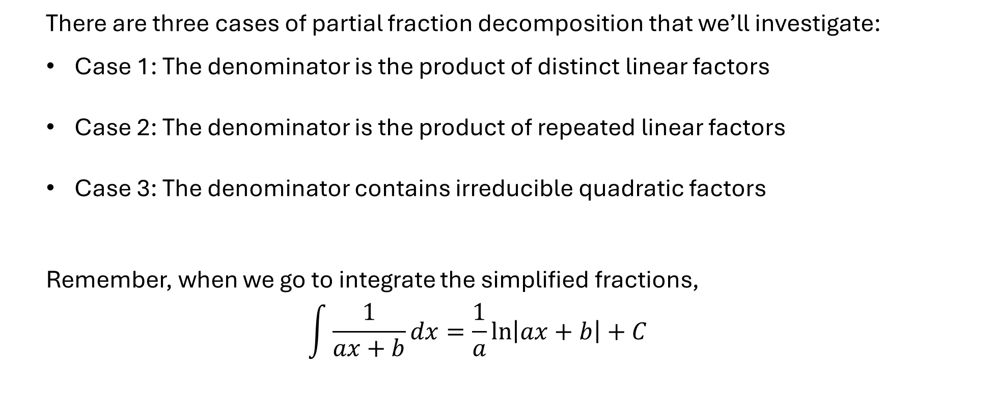
Partial Fraction Decomposition
  There are three cases of partial fraction decomposition that we’ll investigate:
  Case 1: The denominator is the product of distinct linear factors
  Case 2: The denominator is the product of repeated linear factors
  Case 3: The denominator contains irreducible quadratic factors
  Remember, when we go to integrate the simplified fractions,
  $$\int{\frac{1}{ax+b}dx=\frac{1}{a}\ln\left|ax+b\right|+C}$$

